Slide 1
Dockr Container
SlideMake.com

Slide 2
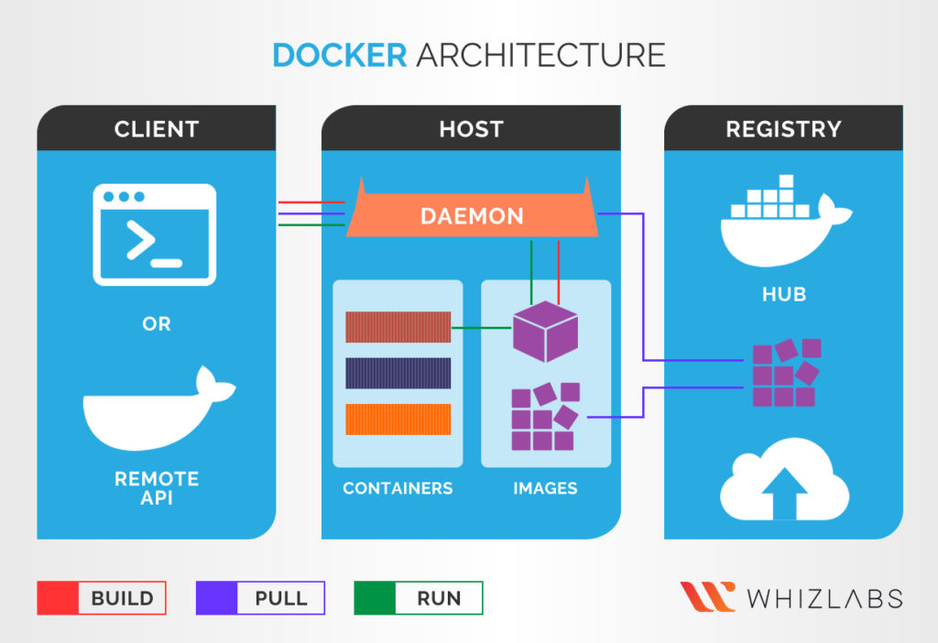
Introduction to Docker Container
Docker container is a lightweight, portable, and self-sufficient software package.
It enables applications and their dependencies to run consistently across different environments.
Docker containers provide isolation, scalability, and easy deployment.
Notes:
Image source: https://www.whizlabs.com/blog/docker-fundamentals/

Slide 3
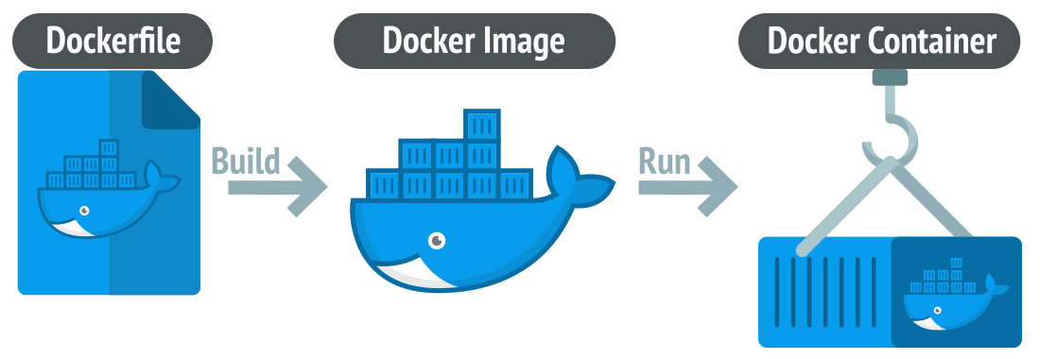
Key Features of Docker Container
Docker containers use operating system-level virtualization to separate applications.
They utilize container images that include everything needed to run an application.
Docker containers are fast to start, stop, and restart, enabling efficient resource utilization.
Notes:
Image source: https://design.udlvirtual.edu.pe/en/how-to-create-a-docker-container-in-azure.html?save=1

Slide 4
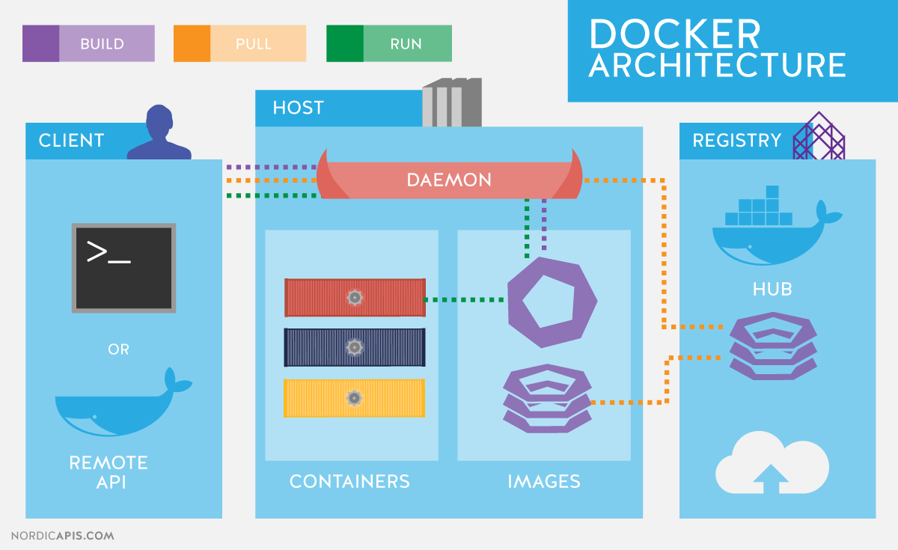
Benefits of Docker Container
Docker containers promote better application portability and compatibility.
They simplify software development and deployment processes.
Docker containers enable efficient utilization of system resources and scalability.
Notes:
Image source: https://what-benefits.com/what-are-the-benefits-of-using-docker

Slide 5
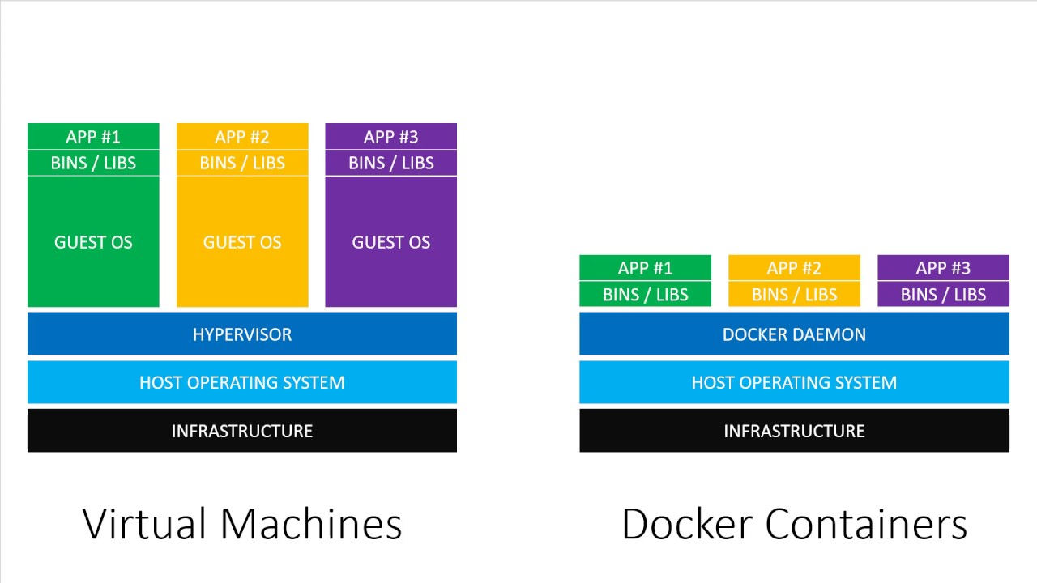
Docker Container vs. Virtual Machines
Docker containers share the host operating system, resulting in less resource overhead.
Containers require fewer system resources compared to virtual machines.
Docker containers provide faster startup times and increased application density.
Notes:
Image source: https://iot.samteck.net/enablers/docker/docker-architecture-and-terms/

Slide 6
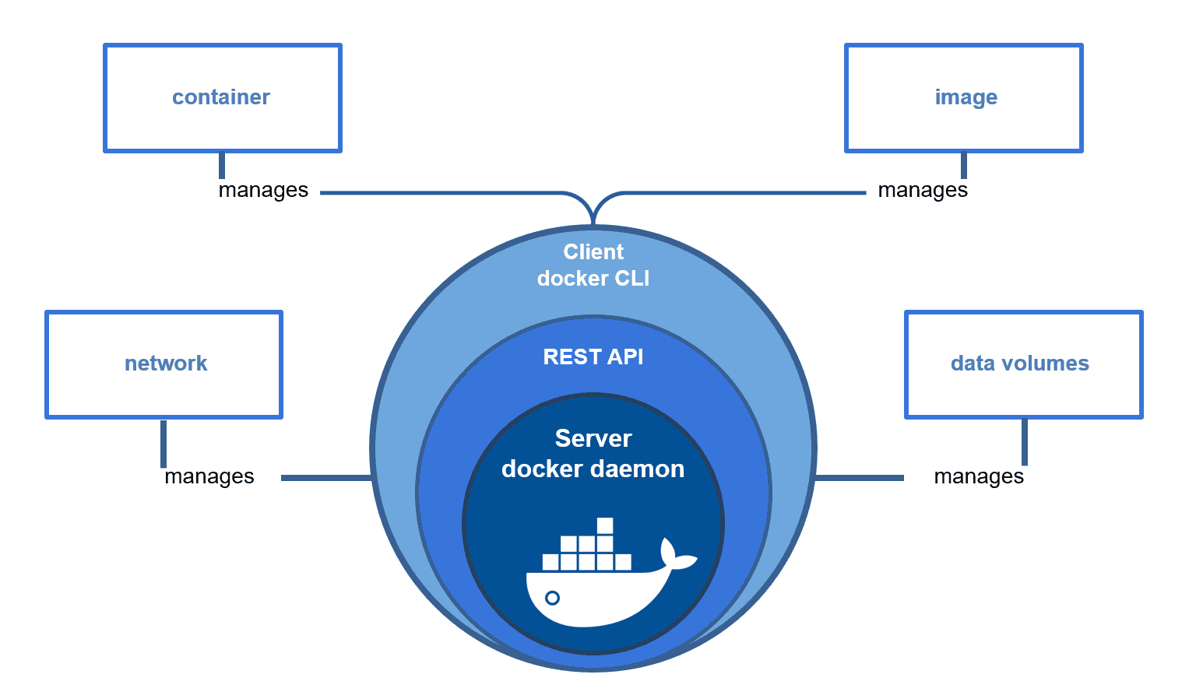
Docker Container Architecture
Docker containers are built on top of Docker Engine, which manages containers.
Docker Engine consists of three main components: Docker Daemon, REST API, and Command Line Interface (CLI).
Containers are created from container images, which are built using Dockerfiles.
Notes:
Image source: https://kodein.hashnode.dev/docker-engine-architecture-a-beginners-shallow-dive

Slide 7
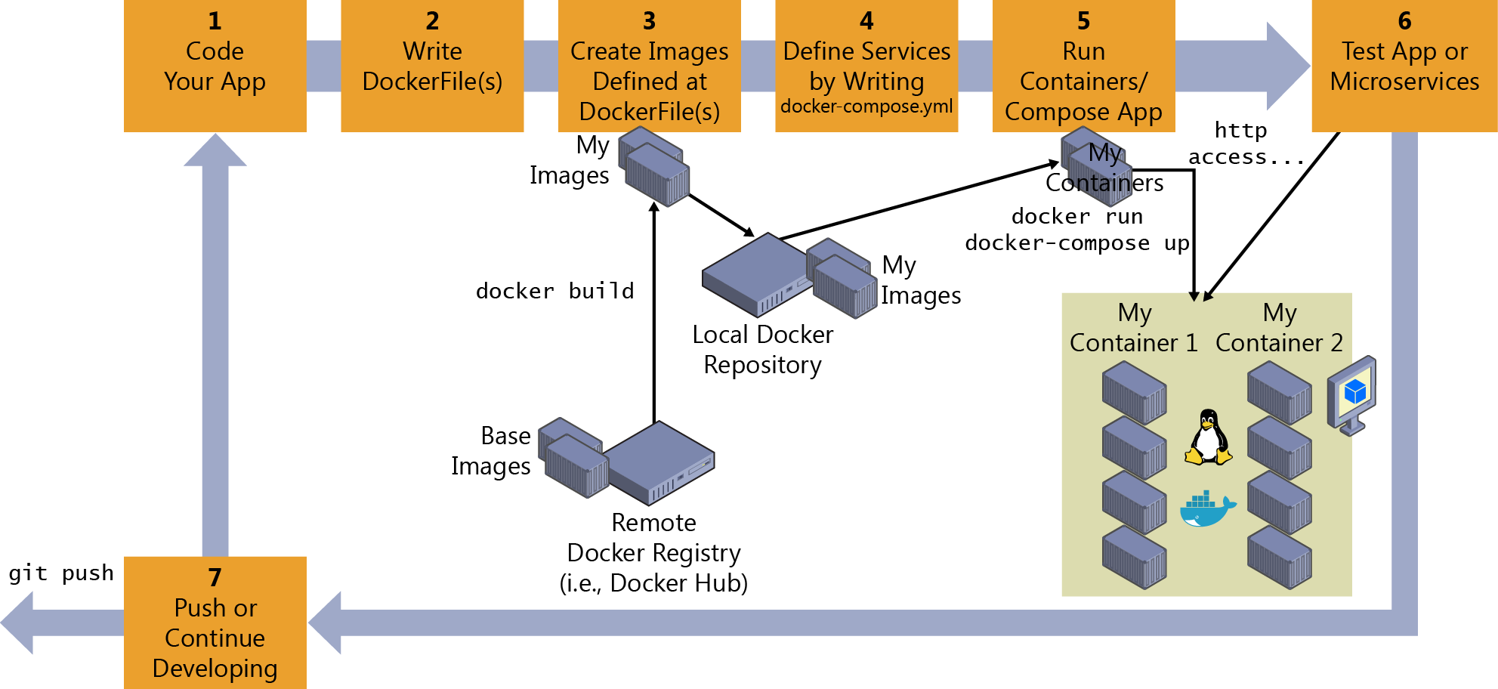
Creating Docker Container Images
Dockerfiles are text files that define steps to build container images.
Docker images are built using a layered approach, allowing efficient reuse and sharing.
Docker Hub and other registries provide a repository for sharing and distributing container images.
Notes:
Image source: https://learn.microsoft.com/en-us/dotnet/architecture/containerized-lifecycle/design-develop-containerized-apps/docker-apps-inner-loop-workflow

Slide 8
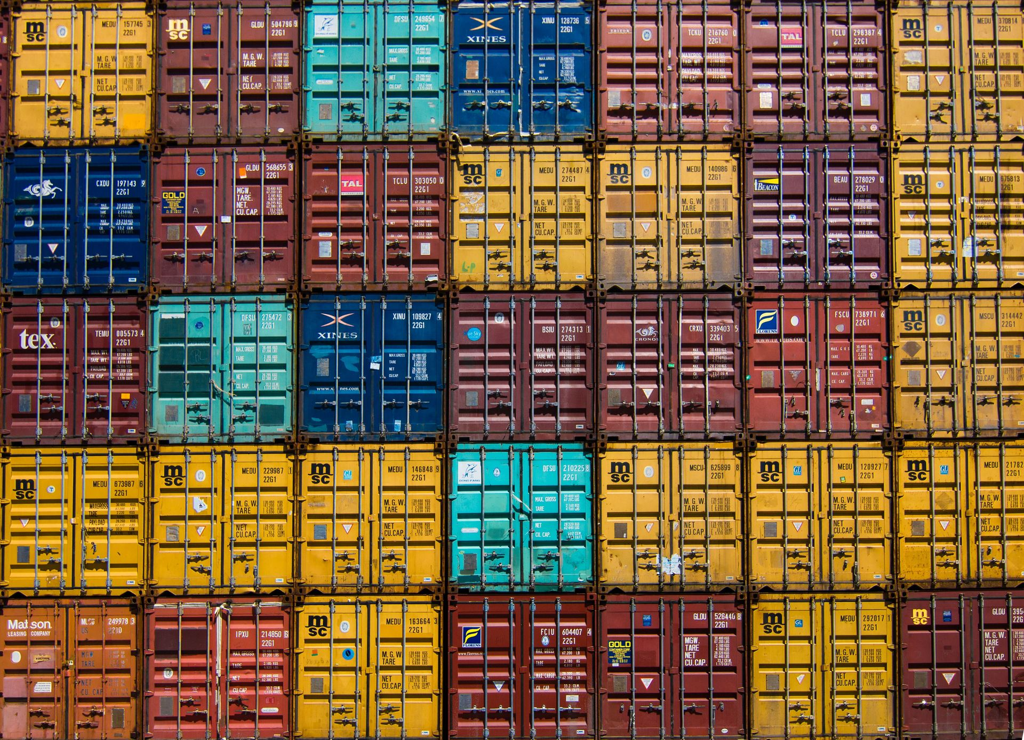
Running Docker Containers
Docker containers are executed using the Docker CLI.
Containers can be started, stopped, and restarted easily.
Docker CLI provides options to manage container networking, volumes, and environment variables.
Notes:
Image source: https://hangarau.space/running-docker-containers-on-ipv6/

Slide 9
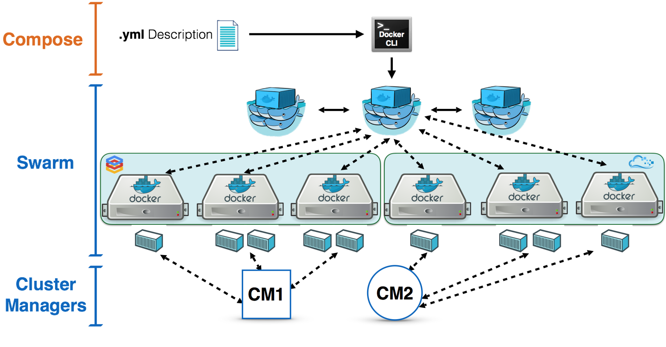
Container Orchestration with Docker Swarm
Docker Swarm enables the orchestration and management of multiple Docker containers across multiple hosts.
Swarm provides load balancing, high availability, and scaling capabilities.
It simplifies the deployment and scaling of containerized applications.
Notes:
Image source: https://dockertips.readthedocs.io/en/latest/docker-swarm/swarm-intro.html

Slide 10
Docker Compose for Multi-Container Applications
Docker Compose is a tool for defining and managing multi-container applications.
It allows defining complex application architectures using YAML files.
Docker Compose simplifies the process of running and scaling multi-container applications.
Notes:
Image source: https://medium.com/bb-tutorials-and-thoughts/docker-compose-part-1-development-environment-for-multi-container-applications-6e3ba461c219

Slide 11
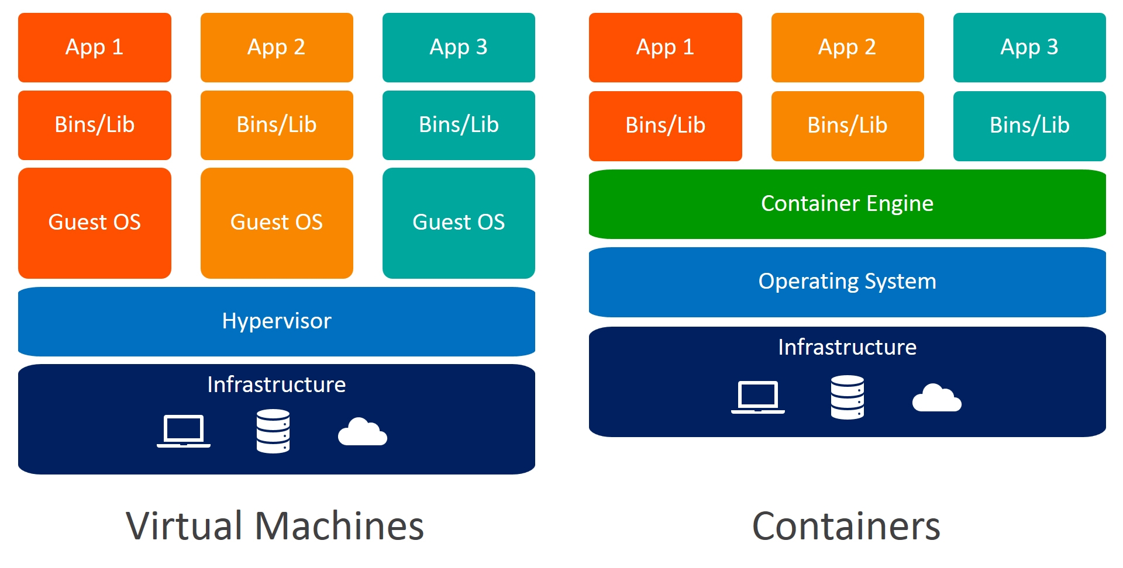
Docker Security Best Practices
Docker container security requires keeping container images up to date.
Implementing least privilege principles and restricting container capabilities enhances security.
Regular vulnerability scanning and compliance checks are essential for maintaining container security.
Notes:
Image source: https://dazzyddos.github.io/posts/Docker-Build-Stage-Security-Best-Practices/

Slide 12
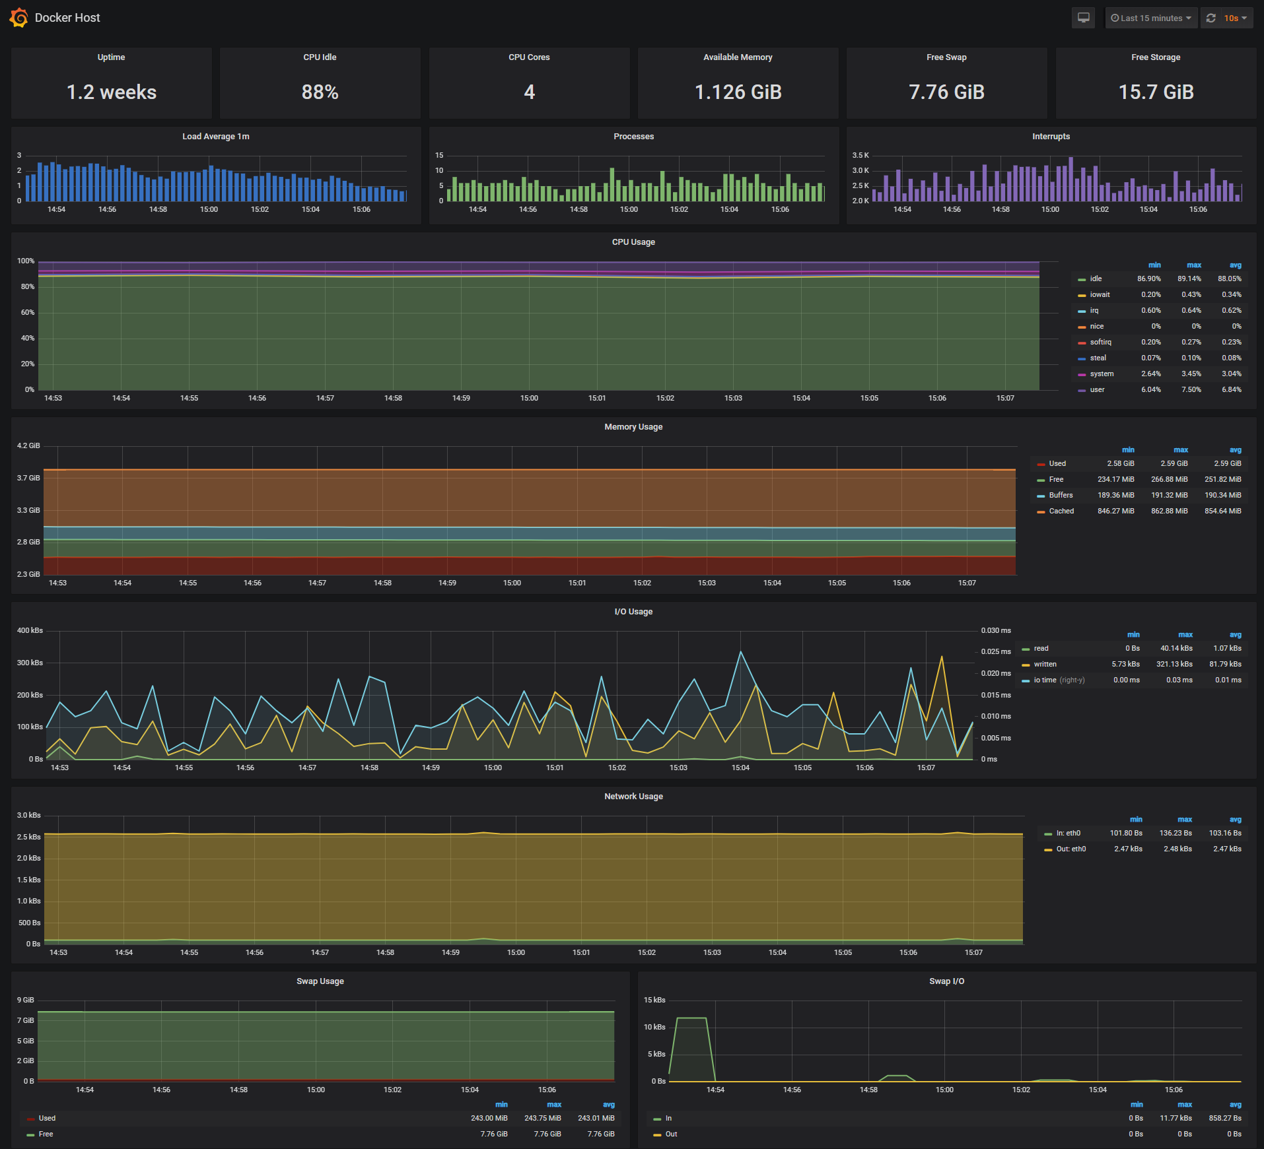
Monitoring and Logging Docker Containers
Docker provides built-in logging capabilities for containers.
Third-party tools like ELK Stack (Elasticsearch, Logstash, Kibana) can be used for advanced log analysis.
Container monitoring tools like Prometheus and Grafana can be integrated to monitor container performance.
Notes:
Image source: https://github.com/magwyen/grafana-docker

Slide 13
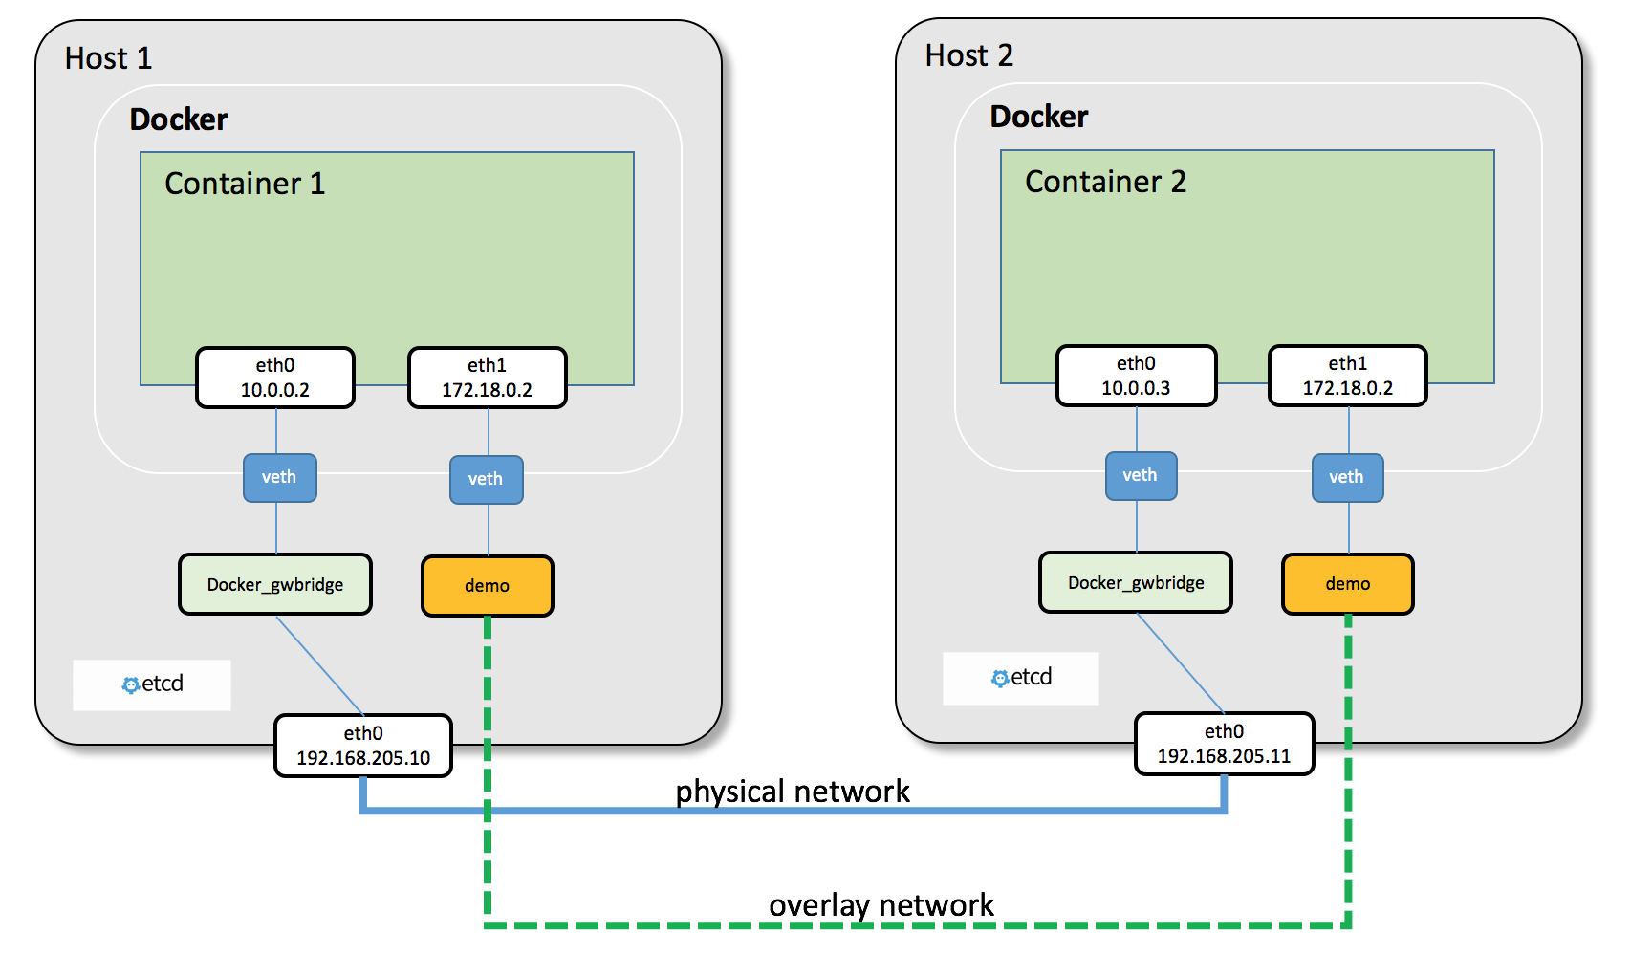
Docker Container Networking
Docker provides different networking options for containers, including bridge, host, and overlay networks.
Docker Swarm and Kubernetes enable container networking across multiple hosts.
Container networking allows efficient communication between containers and with external services.
Notes:
Image source: https://mohittalniya.medium.com/overview-of-docker-networking-lets-connect-the-containers-39b34249ad91

Slide 14
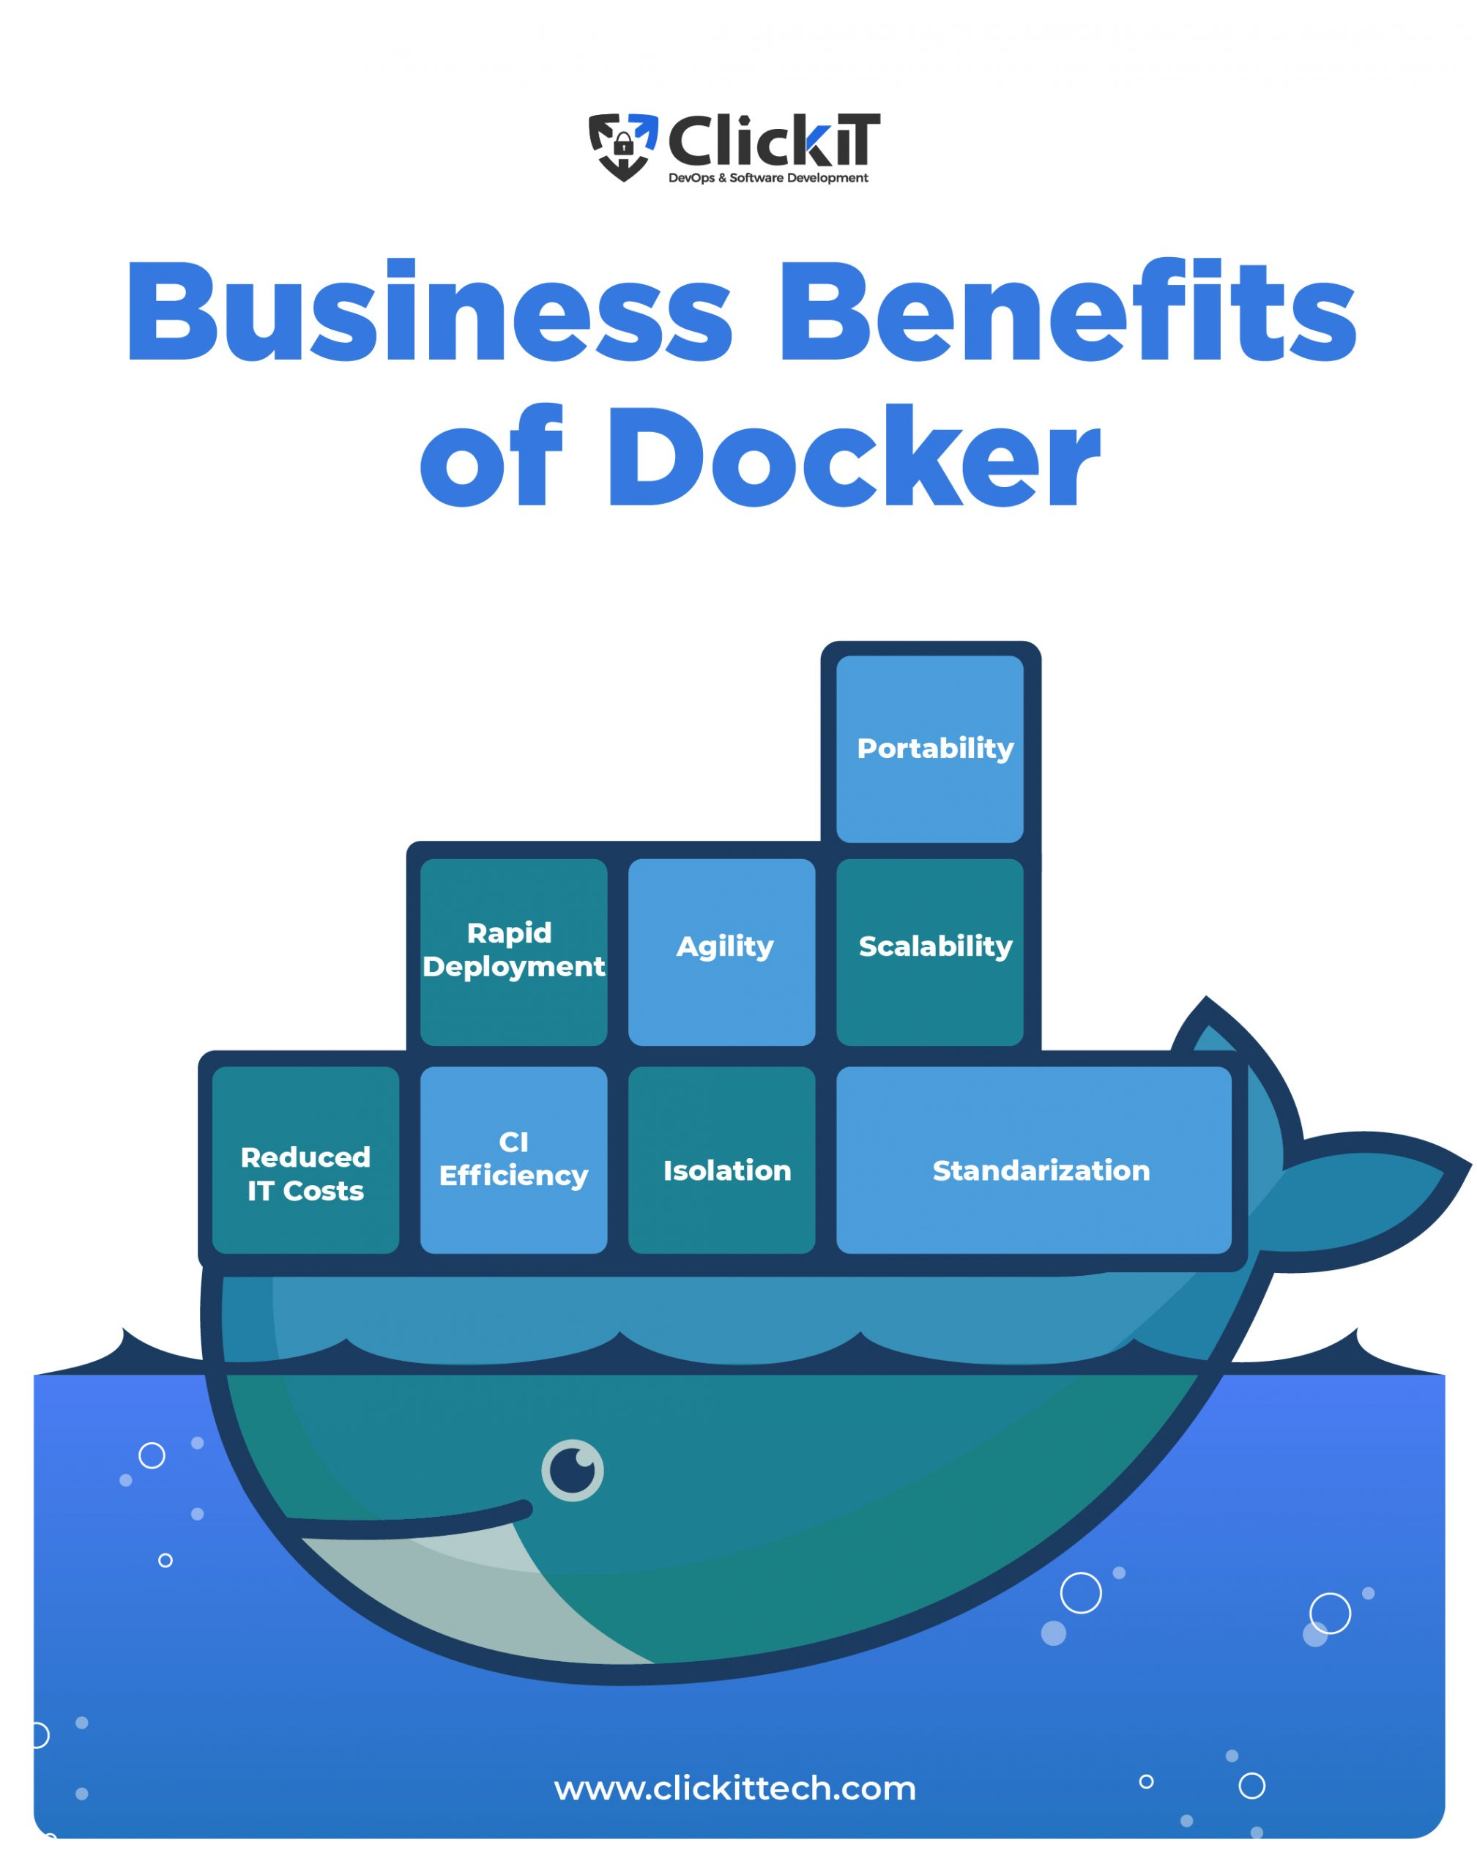
Use Cases for Docker Container
Docker containers are widely used for microservices architectures.
They are used in CI/CD pipelines for consistent software testing and deployment.
Docker containers are also used for creating portable development environments.
Notes:
Image source: https://www.clickittech.com/devops/docker-use-cases/

Slide 15
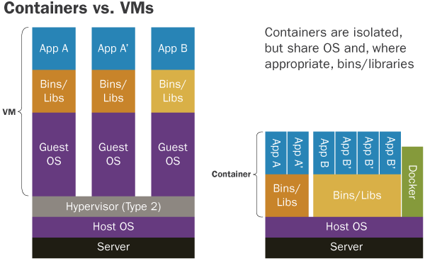
Limitations of Docker Container
Containers share the host operating system, which can lead to security risks.
Containers have limited access to hardware devices.
Containers are not suitable for running applications with high-performance requirements.
Notes:
Image source: https://stackoverflow.com/questions/46211558/ulimits-in-docker-host-vs-container

Slide 16
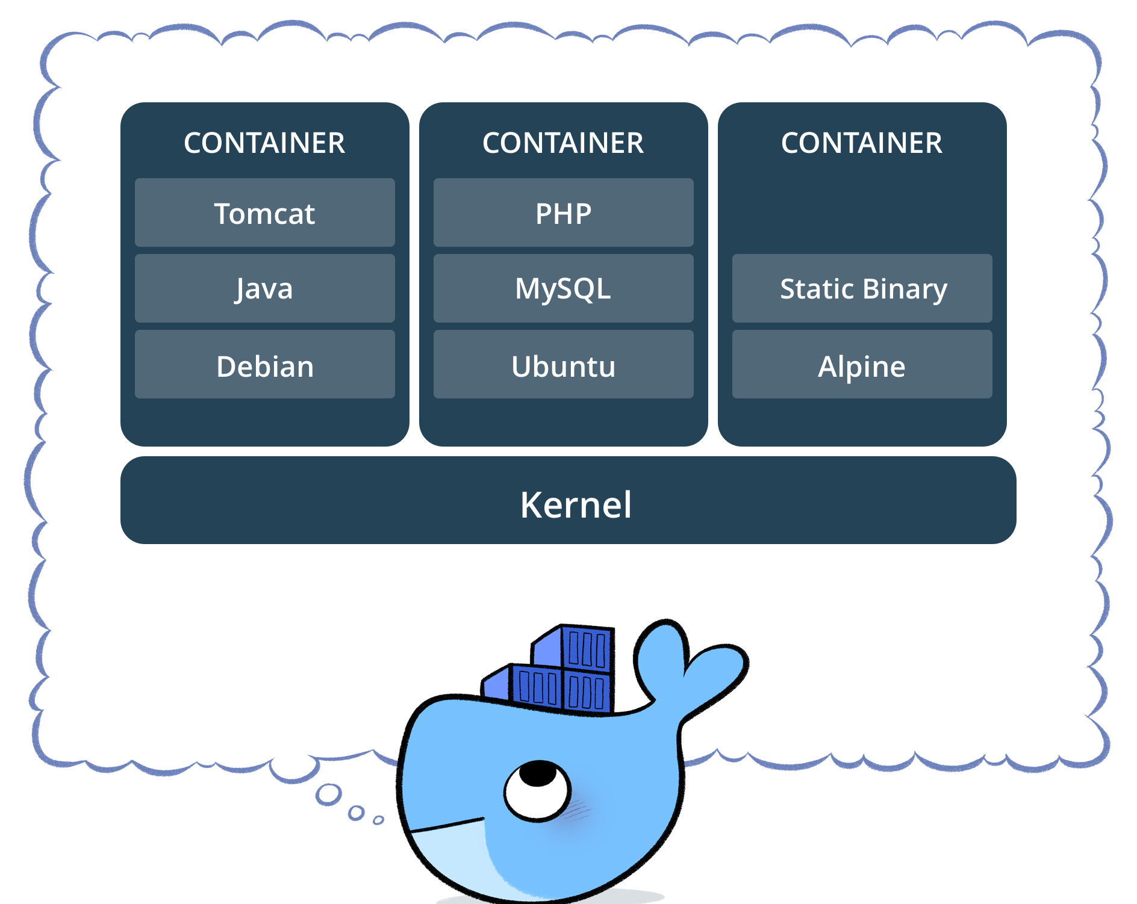
Docker Container Management Tools
Docker provides a range of management tools like Docker Swarm and Kubernetes.
Docker Swarm is a built-in orchestration tool for managing Docker containers.
Kubernetes is a container orchestration platform that supports Docker containers and other container runtimes.
Notes:
Image source: https://cs-geonode.readthedocs.io/en/2.8_a/tutorials/install_and_admin/running_docker/setup_docker.html

Slide 17
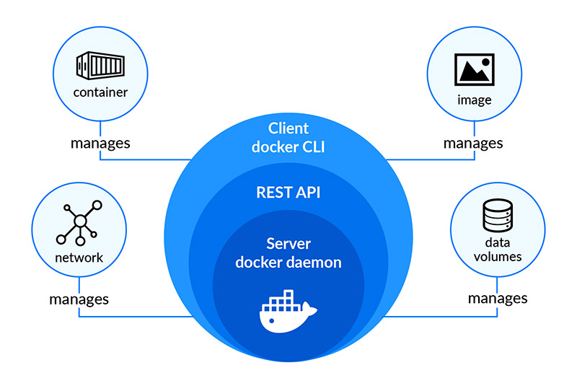
Future Trends in Docker Container
The adoption of containerization is expected to continue growing rapidly.
Serverless computing and edge computing are driving the need for lightweight containers.
The integration of AI and machine learning capabilities into container platforms is a future trend.
Notes:
Image source: https://thinkpalm.com/blogs/everything-need-know-docker-adoption-software-containerization/

Slide 18
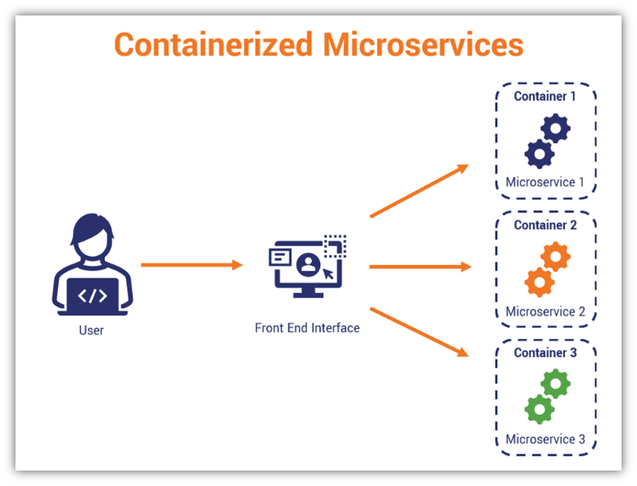
Containerization Challenges and Solutions
Container security challenges can be addressed with proper container hardening and vulnerability scanning.
Container orchestration challenges can be overcome by using tools like Docker Swarm and Kubernetes.
Continuous monitoring and observability can help solve container management and performance challenges.
Notes:
Image source: https://securityboulevard.com/2022/03/the-benefits-and-challenges-of-containerized-microservices/

Slide 19
Conclusion
Docker containers provide an efficient and scalable way to package, deploy, and manage applications.
They enable application portability, compatibility, and isolation.
The future of containerization looks promising with ongoing advancements and adoption.
Notes:
Image source: https://www.f5.com.cn/services/resources/white-papers/using-docker-container-technology-with-f5-products-and-services

Slide 20
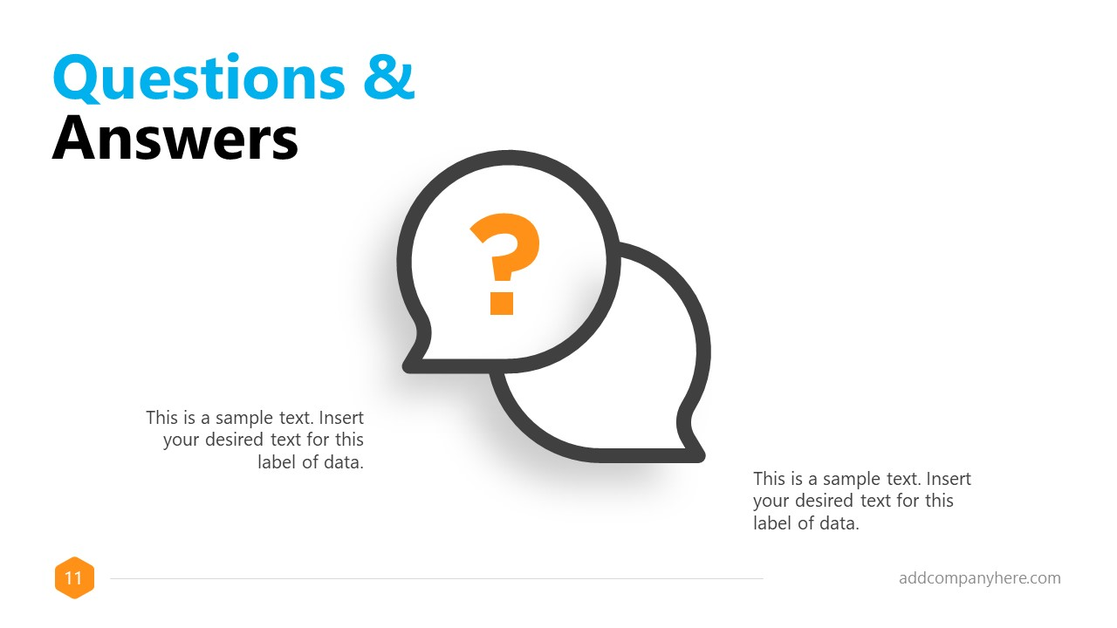
Questions & Answers
Allow time for audience questions and provide answers based on the presentation content.
Your second bullet
Your third bullet
Notes:
Image source: https://slidemodel.com/templates/formal-powerpoint-template/20907-01-formal-powerpoint-template-11-questions-answers/

Slide 21
References
List all the references used for the presentation.
Your second bullet
Your third bullet

